Slide 1
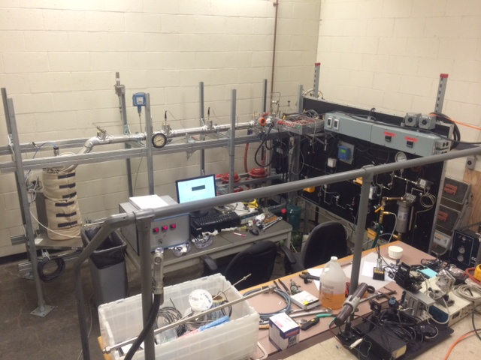
Overview of the MIT IHTFP* Loop
*Internally Heated Testloop for PWRs

Slide 2
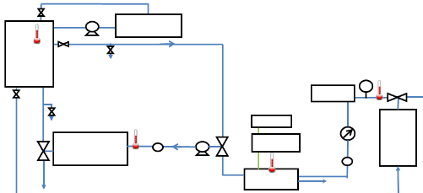
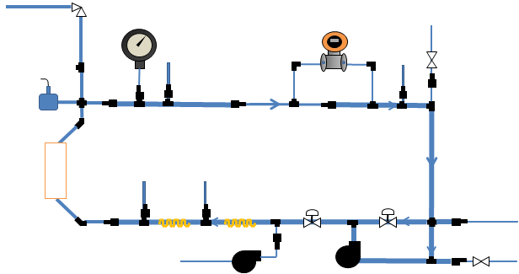
Overview of the MIT IHTFP Loop
Auxiliary Loop
Controls chemistry
Room temperature, slightly pressurized
Auxiliary Loop
Circulation Loop
At actual PWR conditions
Where the CRUD actually grows
Circulation Loop

Slide 3
Main Circulation Loop
Pressure Control
Flow Control
1
Temperature Control
3
2
Increased by pressurizing pump
Measured by pressure transmitter and gauges
Set by back-pressure regulator
Increased by autoclave heating rod and pre-heater
Measured by thermocouples in autoclave and on the loop
Increased by circulation pump
Measured by differential pressure transmitter
Moderated by control valve
1
1
1
2
2
2
3
3
To Vent
Differential Pressure Sensor
Vacuum Terminal
1 Inch tubing
Pressure Relief Valve
3/4 Inch tubing
1/2 Inch tubing
1/4 Inch tubing
Pressure switch
Pressure Gauge
Thermocouple
Control Valve
Autoclave
Control Valve
To Auxiliary Loop
Pre-heater
Fill Terminal
From Water Tank
Fill Terminal
Pressurizing Pump
Circulation Pump

Slide 4
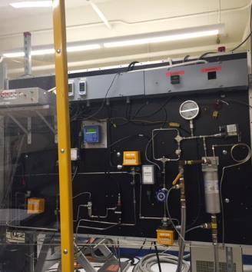
Auxiliary Chemistry Control Loop
Small pump
Ion Exchange Resin Container
Water Tank
Pressure Gauge
Pressure transmitter
Drain
Cooler
pressure
regulator
Measurement equipment
pH, Dissolved O₂, Conductivity
Small pump
Drain
From Circulation Loop
To Circulation Loop
Pressurizing pump
Valve
Flow Sensor
Temperature Probe

Slide 5
Comparison of IHTFP to a PWR
 | PWR | IHTFP
Pressure | 15.5 MPa | 15.5 MPa
Temperature | 287-324°C | 320°C
Reynolds Number | 5 · 10⁵ | 1.62 · 10⁵
Mass flux | 3500 kg/m²s | 1920 kg/m²s
Fe₃O₄, NiO | 0.01 - 0.1 ppm | 10 - 100 ppm

Slide 6
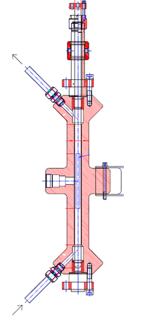
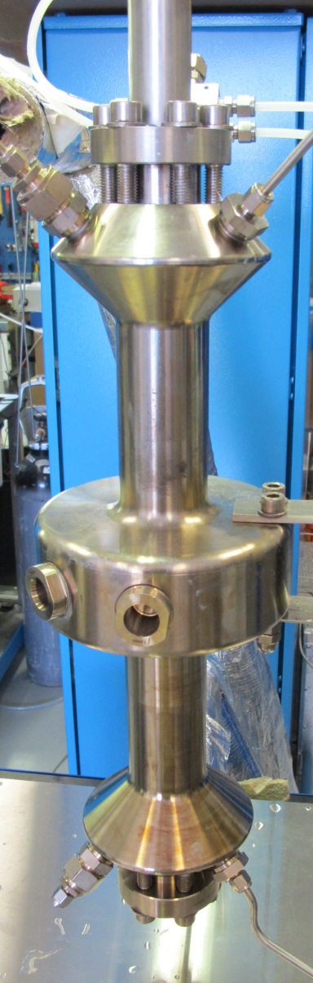
Where the Magic Happens: The Autoclave
Water out
Actual Autoclave
Sapphire
Windows
Water in

Slide 7

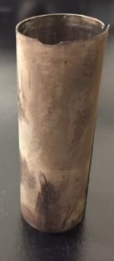



First CRUD Growth after One Week
Sample Ring
Heater
Flow Ring
CRUD grown:
Heater Temperature: 470 Celsius
Water Temperature: 320 Celsius
Pressure:155 bars
7 days

Slide 8
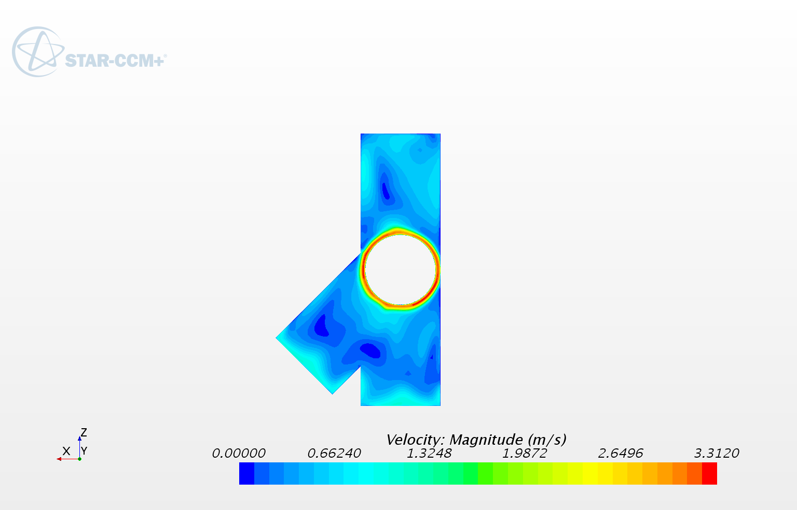
CFD Shows Minimal Flow Disturbance
CFD analysis courtesy of Akshay Dave, Victor Petrov, Annalisa Manera of U. Michigan
Flow remains relatively uniform around heating rod

Slide 9
IHTFP Meshing and Modeling

Slide 10
IHTFP Simulated Fluid Flow

Slide 11
IHTFP Simulated Wall Shear Stresses

Slide 12
CFD-Predicted Quantities

Slide 13
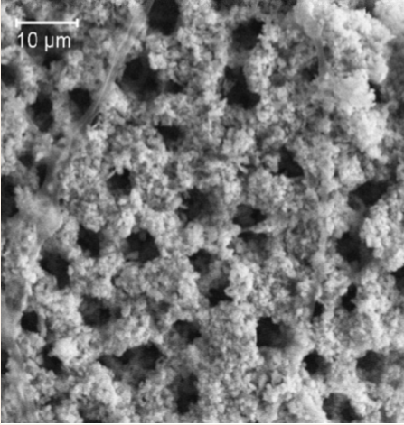
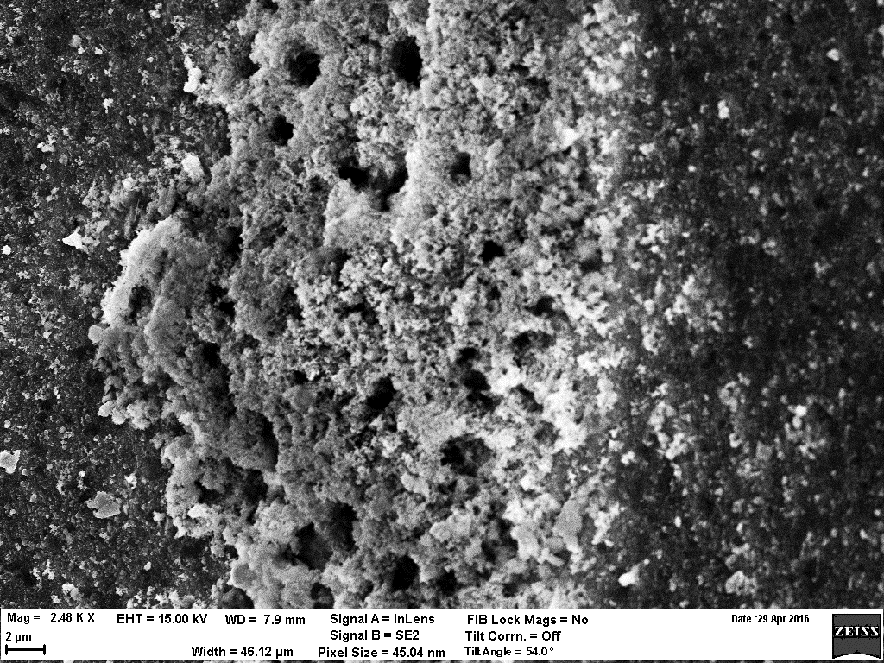
IHTFP vs. PWR CRUD
Can you tell which is which?

Slide 14

IHTFP vs. Plant CRUD and Beyond

Slide 15


Validating MAMBA-BDM Assumptions
Fractalline Material Property Models
Wikimedia Commons: “Box Counting Method”

Slide 16
To Discuss…
What datasets do MAMBA 1D/3D need?
Which conditions predict which phases from thermodynamics? What would you like us to look for?
Can we confirm the CRUD erosion term with coupled MAMBA 3D & CFD?
What else do you want to see?

